Slide 1
FEATURES OF PROBABILITY DISTRIBUTIONS

Slide 2
Reminder: random variables
a variable that takes on different values subject to chance
Two types of random variables:
Discrete: take on countably many values
E.g. rolling a 6-sided die
Continuous: take on uncountably many values
E.g. the computer time (in seconds) required to process a program

Slide 3
I. Central tendency: mean (expected value)
Notation: E(X) or μ_{x}
Definition: a weighted average of all possible values of X
E.g. rolling a 6-sided die
E(X)=1/6*1+1/6*2+1/6*3+1/6*4+1/6*5+1/6*6=3.5
Intuition: the expected value is simply the average outcome of the random variable

Slide 4
I. Central tendency: mean (expected value)
Properties:
if C=constant, then E(C)=C
if A, B=constants, then
E(AX+BY) = AE(X) + BE(Y)
The expected value passes through linear functions!

Slide 5
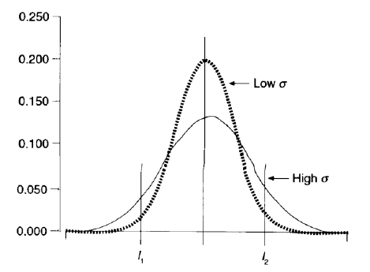
II. Dispersion: variance
Notation: var(X) or σ²
Definition: var(X)=E(X- μ_{x})²
Intuition: how far is each possible value of X from the mean, on average

Slide 6
II. Dispersion: variance
Properties:
if C=constant, var(C)=0; o.w. var(X)>0
Var(AX+B)= A²var(X)
if X are Y are independent, then
var(AX+BY) = A²var(X) + B²var(Y)
(for A, B=constants)

Slide 7
III. Association: covariance
Notation: cov(X,Y) or σ_{XY}
Definition: cov(X,Y) =E[(X- μ_{x}) (Y- μ_{Y}) ]
Intuition: cov(X,Y) is a measure of how the two variables X and Y are related:
cov(X,Y)>0 indicates X and Y tend to move in the same direction (e.g. education and earnings)
cov(X,Y)<0 indicates X and Y tend to move in the opposite direction (e.g. education and crimes)

Slide 8
III. Association: covariance
Properties:
if X=Y, then cov(X,X)=var(X)
if X are Y are independent, then cov(X,Y)=0
cov (AX + B, CY + D) =AC cov(X,Y)
if X are Y are NOT independent, then
var(AX+BY)=A²var(X)+B²var(Y)+2ABcov(X,Y)
(for A, B=constants)

Slide 9
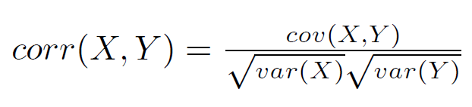
III. Association: correlation
Notation: corr(X,Y) or ρ_{XY}
Definition:
Properties:
-1<=corr(X,Y)<=1
its magnitude shows the strength of the linear relationship between X and Y - the closer to 1 in absolute value, the stronger the relationship
does not depend on the units of measurement

Slide 10
IV. Central tendency: median
Notation: med(X)
if X is continuous, the med(X) is the value of X s.t. ½ of the area under the PDF is to the left and ½ is to the right of it
if X is discrete, the med(X) is the value which is in the middle when ordering all possible values of X

Slide 11
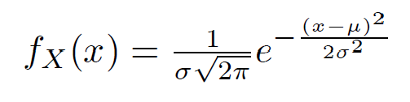


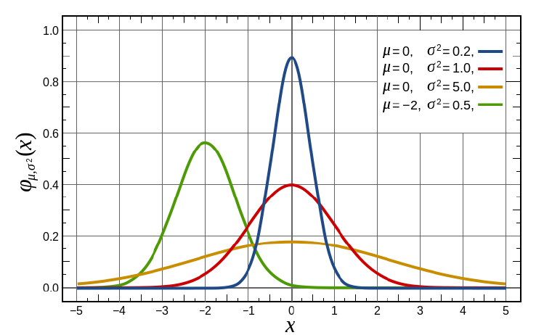
V. Normal distribution

